Slide 1
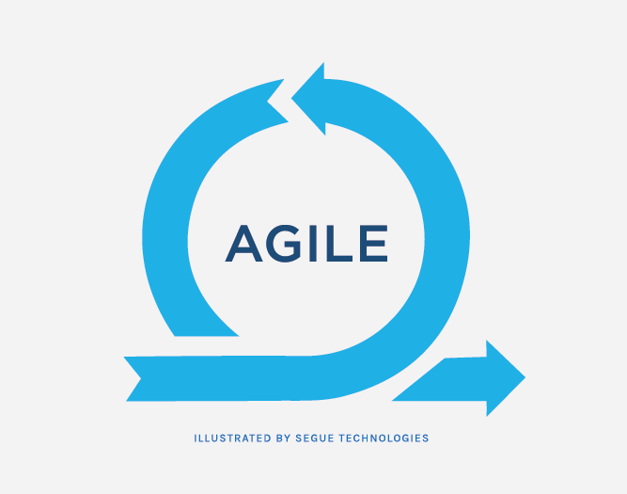
Agile Development & Scrum
by
Erick Garcia

Slide 2
Agile Development is…
A methodology
Its not an exact way of writing requirements
Its more of a project management tool
Flexible

Slide 3
Agile Development is…
A methodology
Iterative
Sprint based
Waterfall vs agile development
Notes:
Work for a while, review and make all the necessary changes
The development is iterative in small sprints a week or two week time spans

Slide 4
Agile Development is…
A methodology
Iterative
Streamlined
Getting the work done vs tons of documentation
Small meetings
Notes:
make (an organization or system) more efficient and effective by employing faster or simpler working methods.

Slide 5
Agile Development is…
A methodology
Iterative
Streamlined
Time-boxed
Time-based development vs feature-based development
Notes:
We want to do features A, B, and C and we are going to try to do them in 3 weeks
We are going to plan 3 weeks of development, and try to get done features A, B, and C
If halfway during the sprint we are done we can add feature D because we planned 3 weeks of development
Development is based on time and not on features

Slide 6
Agile Development is…
A methodology
Iterative
Streamlined
Time-boxed
Very Collaborative
You don’t disappear for two weeks and come back with a finished product
Notes:
Everyone is constantly talking to each other
No one disappears
A lot of team work

Slide 7
Agile Development is…
A methodology
Its not an exact way of writing requirements
Its more of a project management tool
Flexible
Iterative
Sprint based
Waterfall vs agile development
Streamlined
Getting the work done vs tons of documentation
Small meetings
Time-boxed
Time-based development vs feature-based development
Very Collaborative
You don’t disappear for two weeks and come back with a finished product

Slide 8
Real-world Scenario
Notes:
Client tries to get an agile-company to build an app
How much is it going to cost?
An agile developer will answer by: It will probably take about 3 months and it costs 5,000 dollars a month; but we are confident in building it in 3 months
Client takes a leap of faith
First couple of weeks is highly interactive with the customer, instead of just writing a huge documentation
After a sprint or two we get a release with minimal features, client’s stress lowers
Application is coming to life and since we get frequent releases change is possible
Asses the changes in terms of time
Constant feedback
For agile to work we need Honest collaborative developers and an engaged client

Slide 9

Scrum is…
Not an acronym
An iterative and incremental agile software development framework for managing product development.
Notes:
They borrowed the name from the game of rugby to stress the importance of teams in complex product development.
Their research showed that outstanding performance is achieved when teams are small and self-organizing units of people and when such teams are fed with objectives, not with executable tasks
In rugby union a scrum is a means of restarting play after a minor infringement. It involves up to eight players from each team, known as the pack or forward pack, binding together in three rows and interlocking with the free opposing teams forwards. At this point the ball is fed into the gap between the two forward packs and they both compete for the ball to win possession. Teams can be penalised for intentionally causing the scrum to collapse, and for not putting the ball into the scrum correctly. A scrum is most commonly awarded when the ball is knocked forward, or passed forward, or when a ball becomes trapped in a ruck or maul. Because of the physical nature of scrums, injuries can occur, especially in the front row.

Slide 10
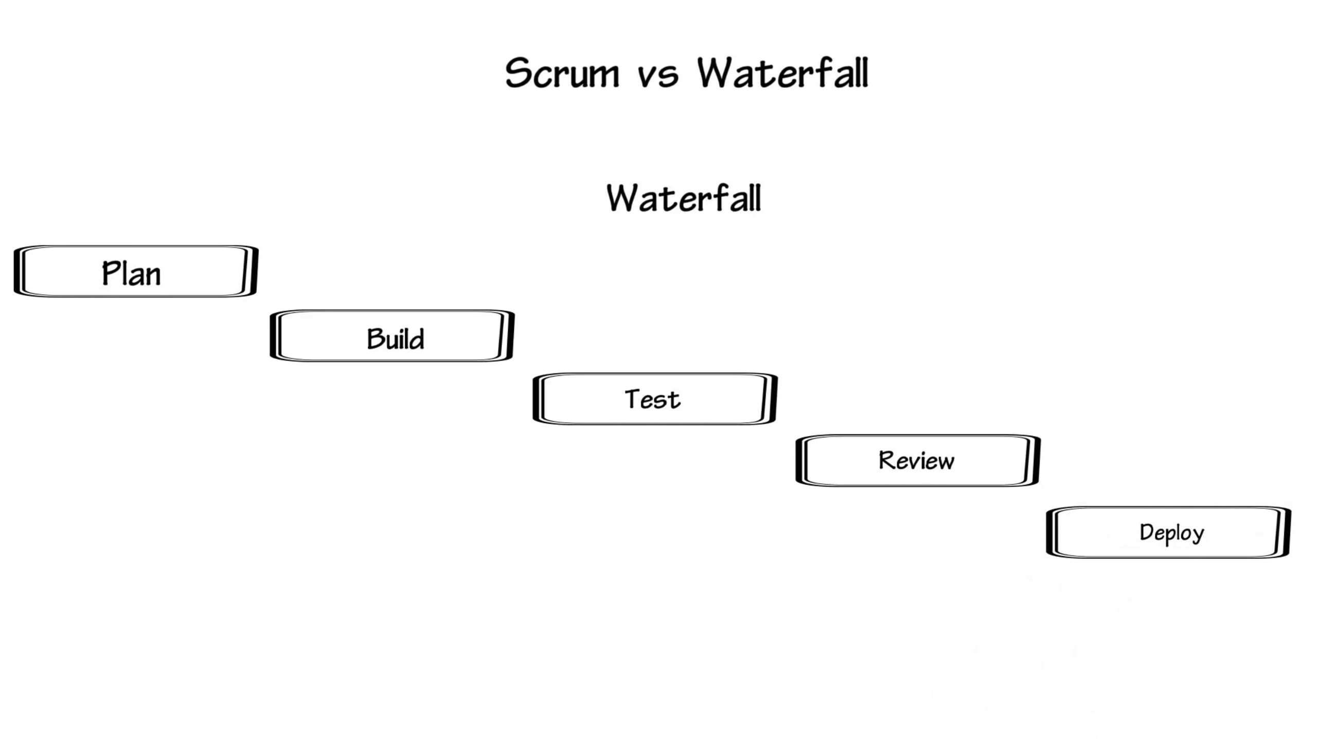
Notes:
It is a lengthy planning process which can take a lot of time
Write a very big specification (documentation)
It is like building a building once the blueprint is done you don’t make any changes

Slide 11
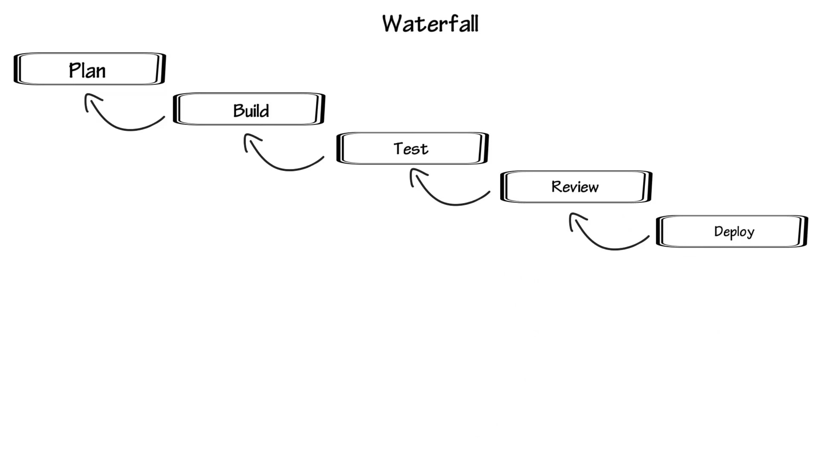
Notes:
All the planning is done without fully understanding the product
When developing is done, things get sent back to planning and maybe you need to start over
Developers can be criticized for not understanding the project
This all comes down to many months to getting a project in production

Slide 12
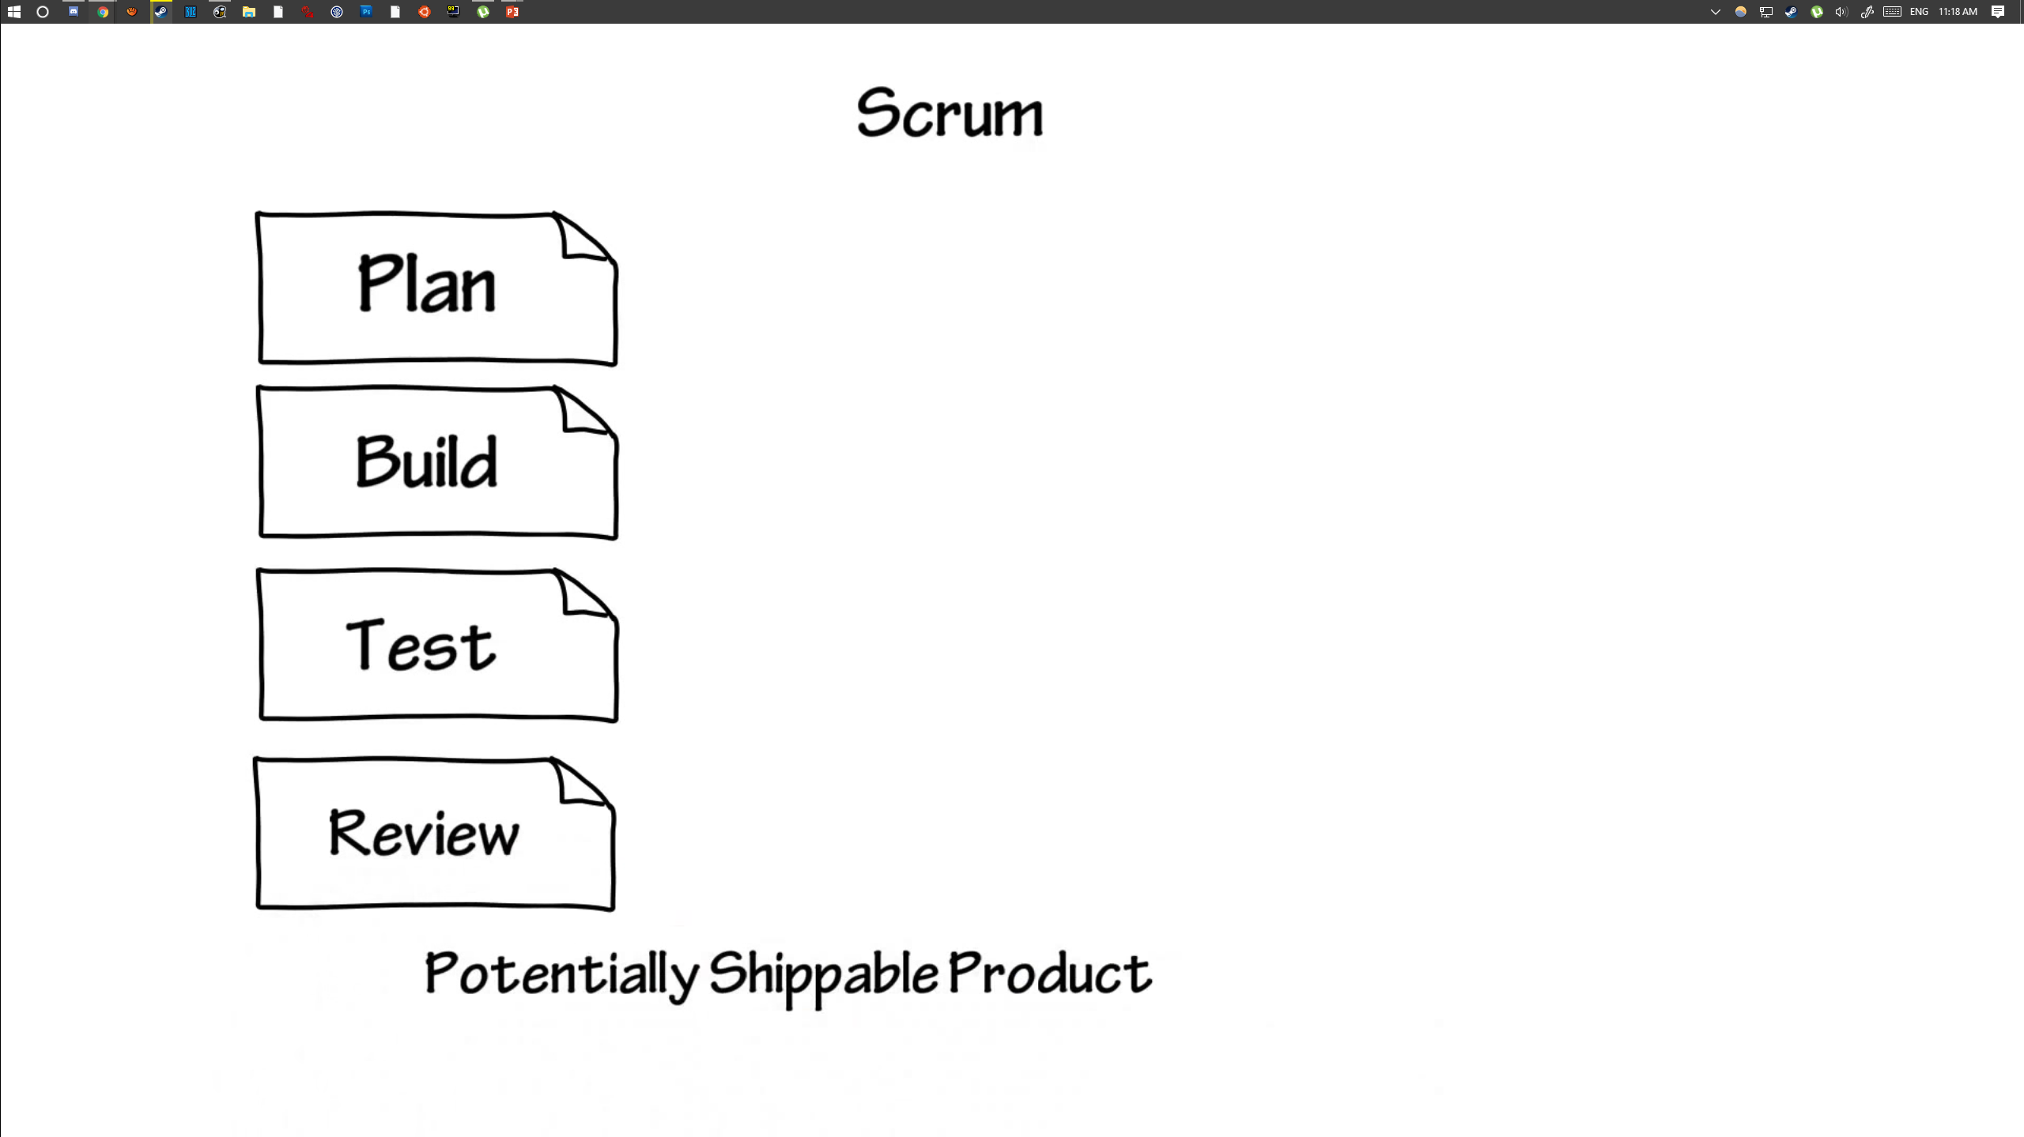
Notes:
Just enough planning to get started to build the minimum feature set
Build what was planned
Test that feature set
Review that feature set
At the end we end up with a potentially shippable product

Slide 13
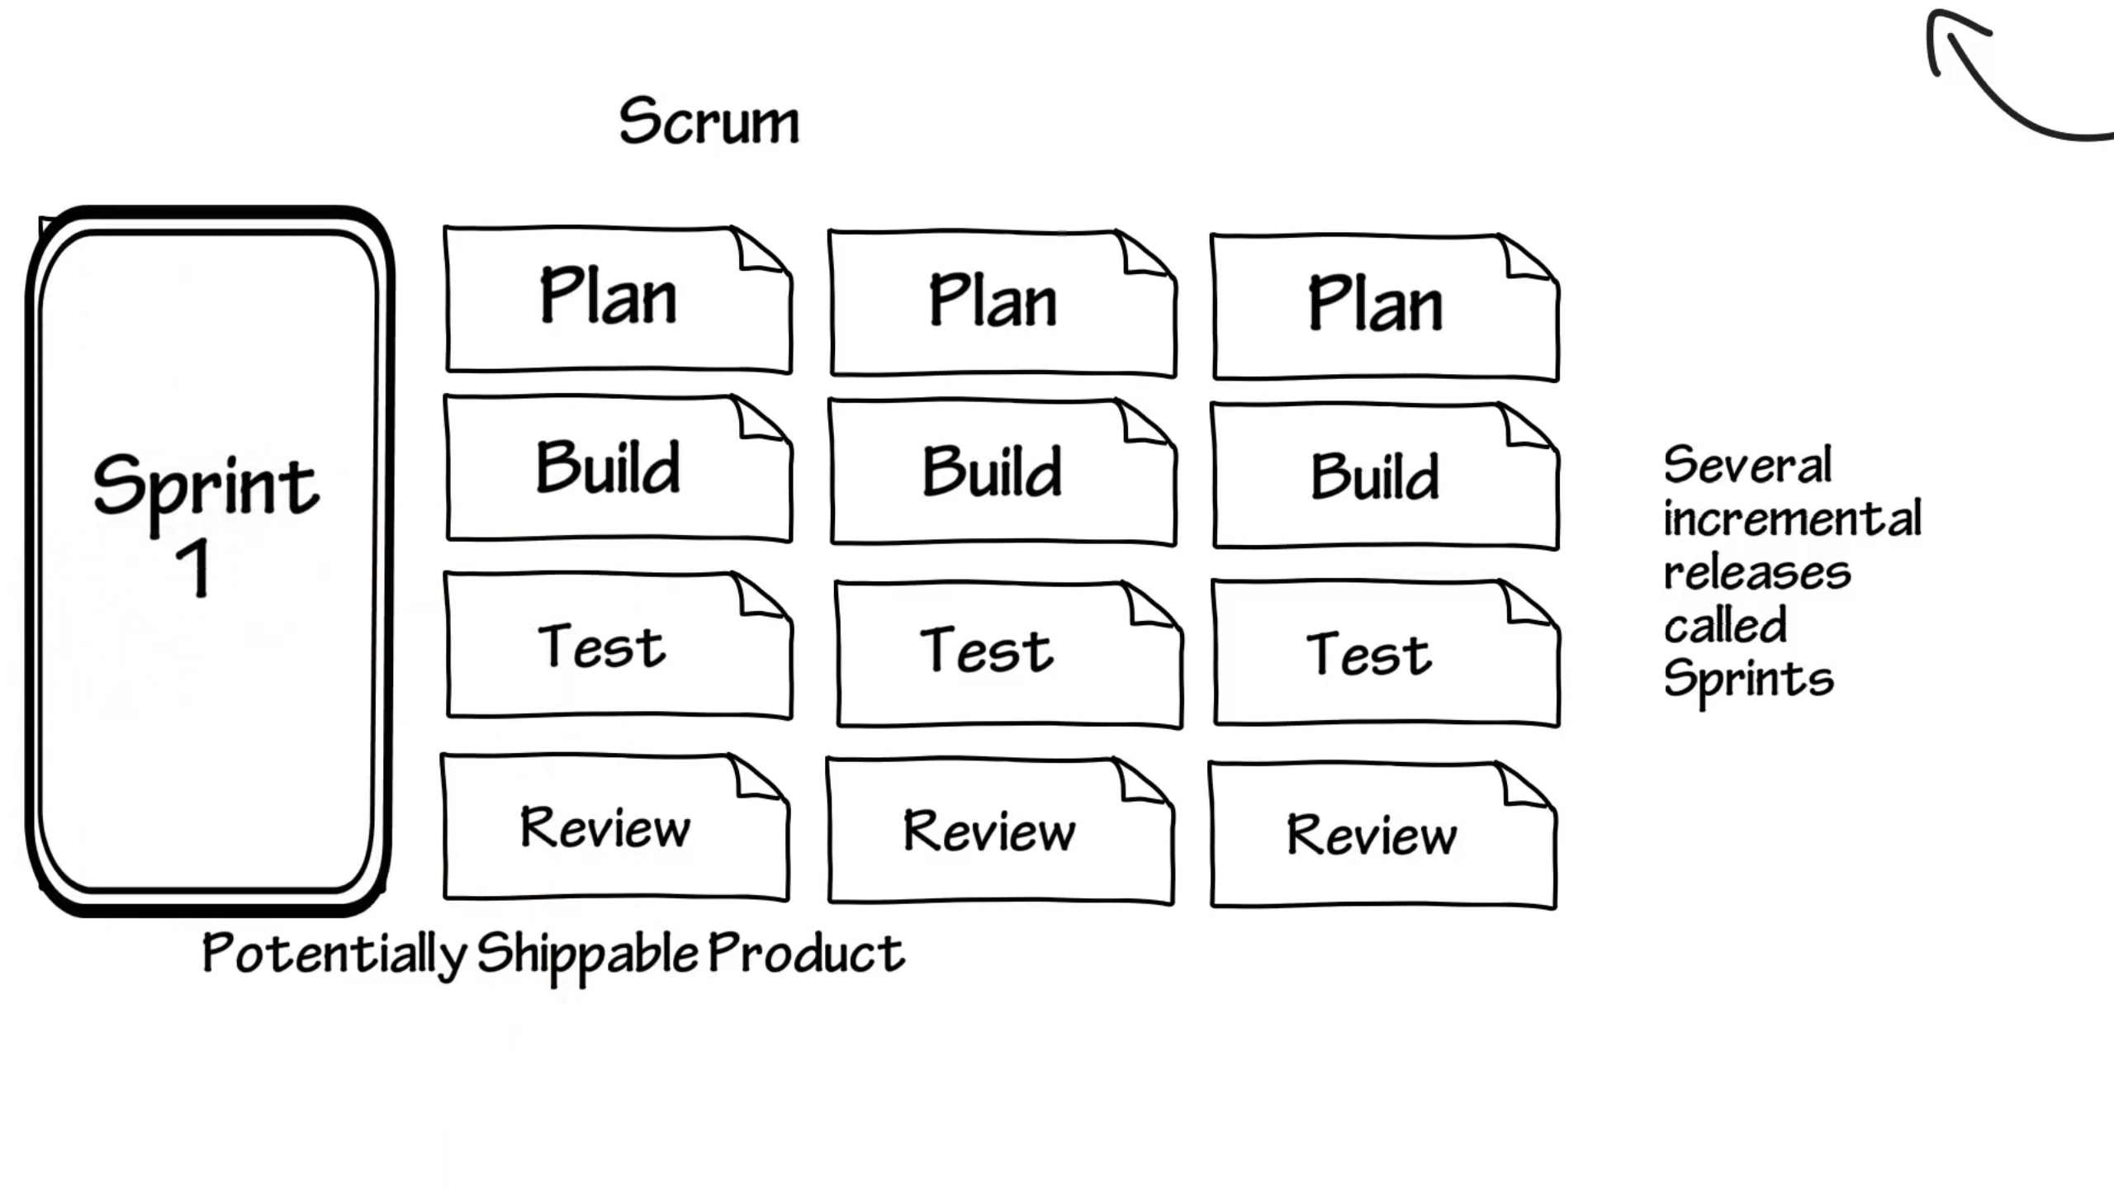
Notes:
We end up with several incremental releases called sprints
We can maybe start shipping product at the second or third sprint

Slide 14
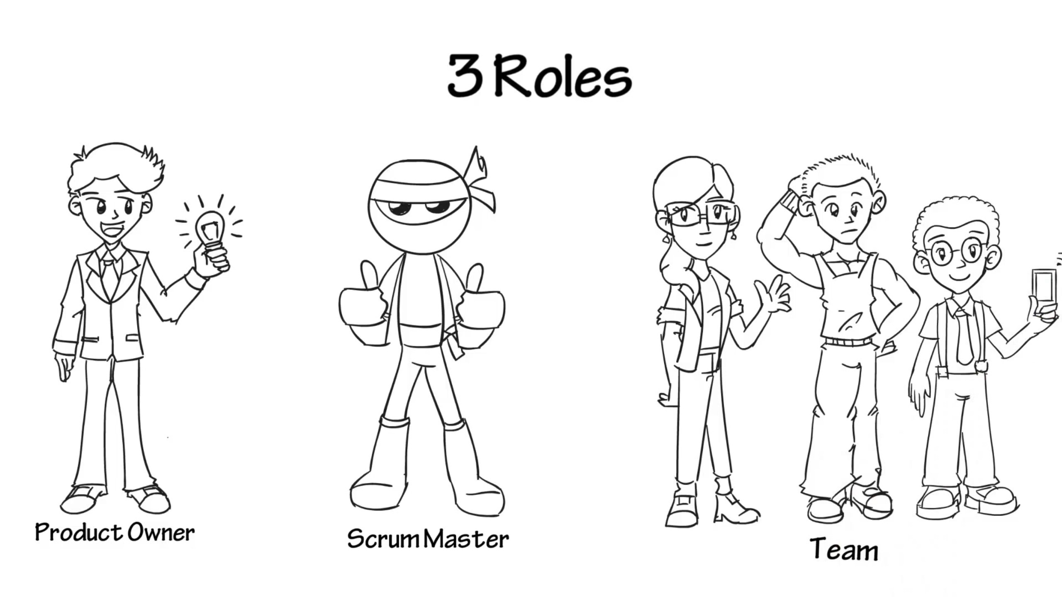

Slide 15
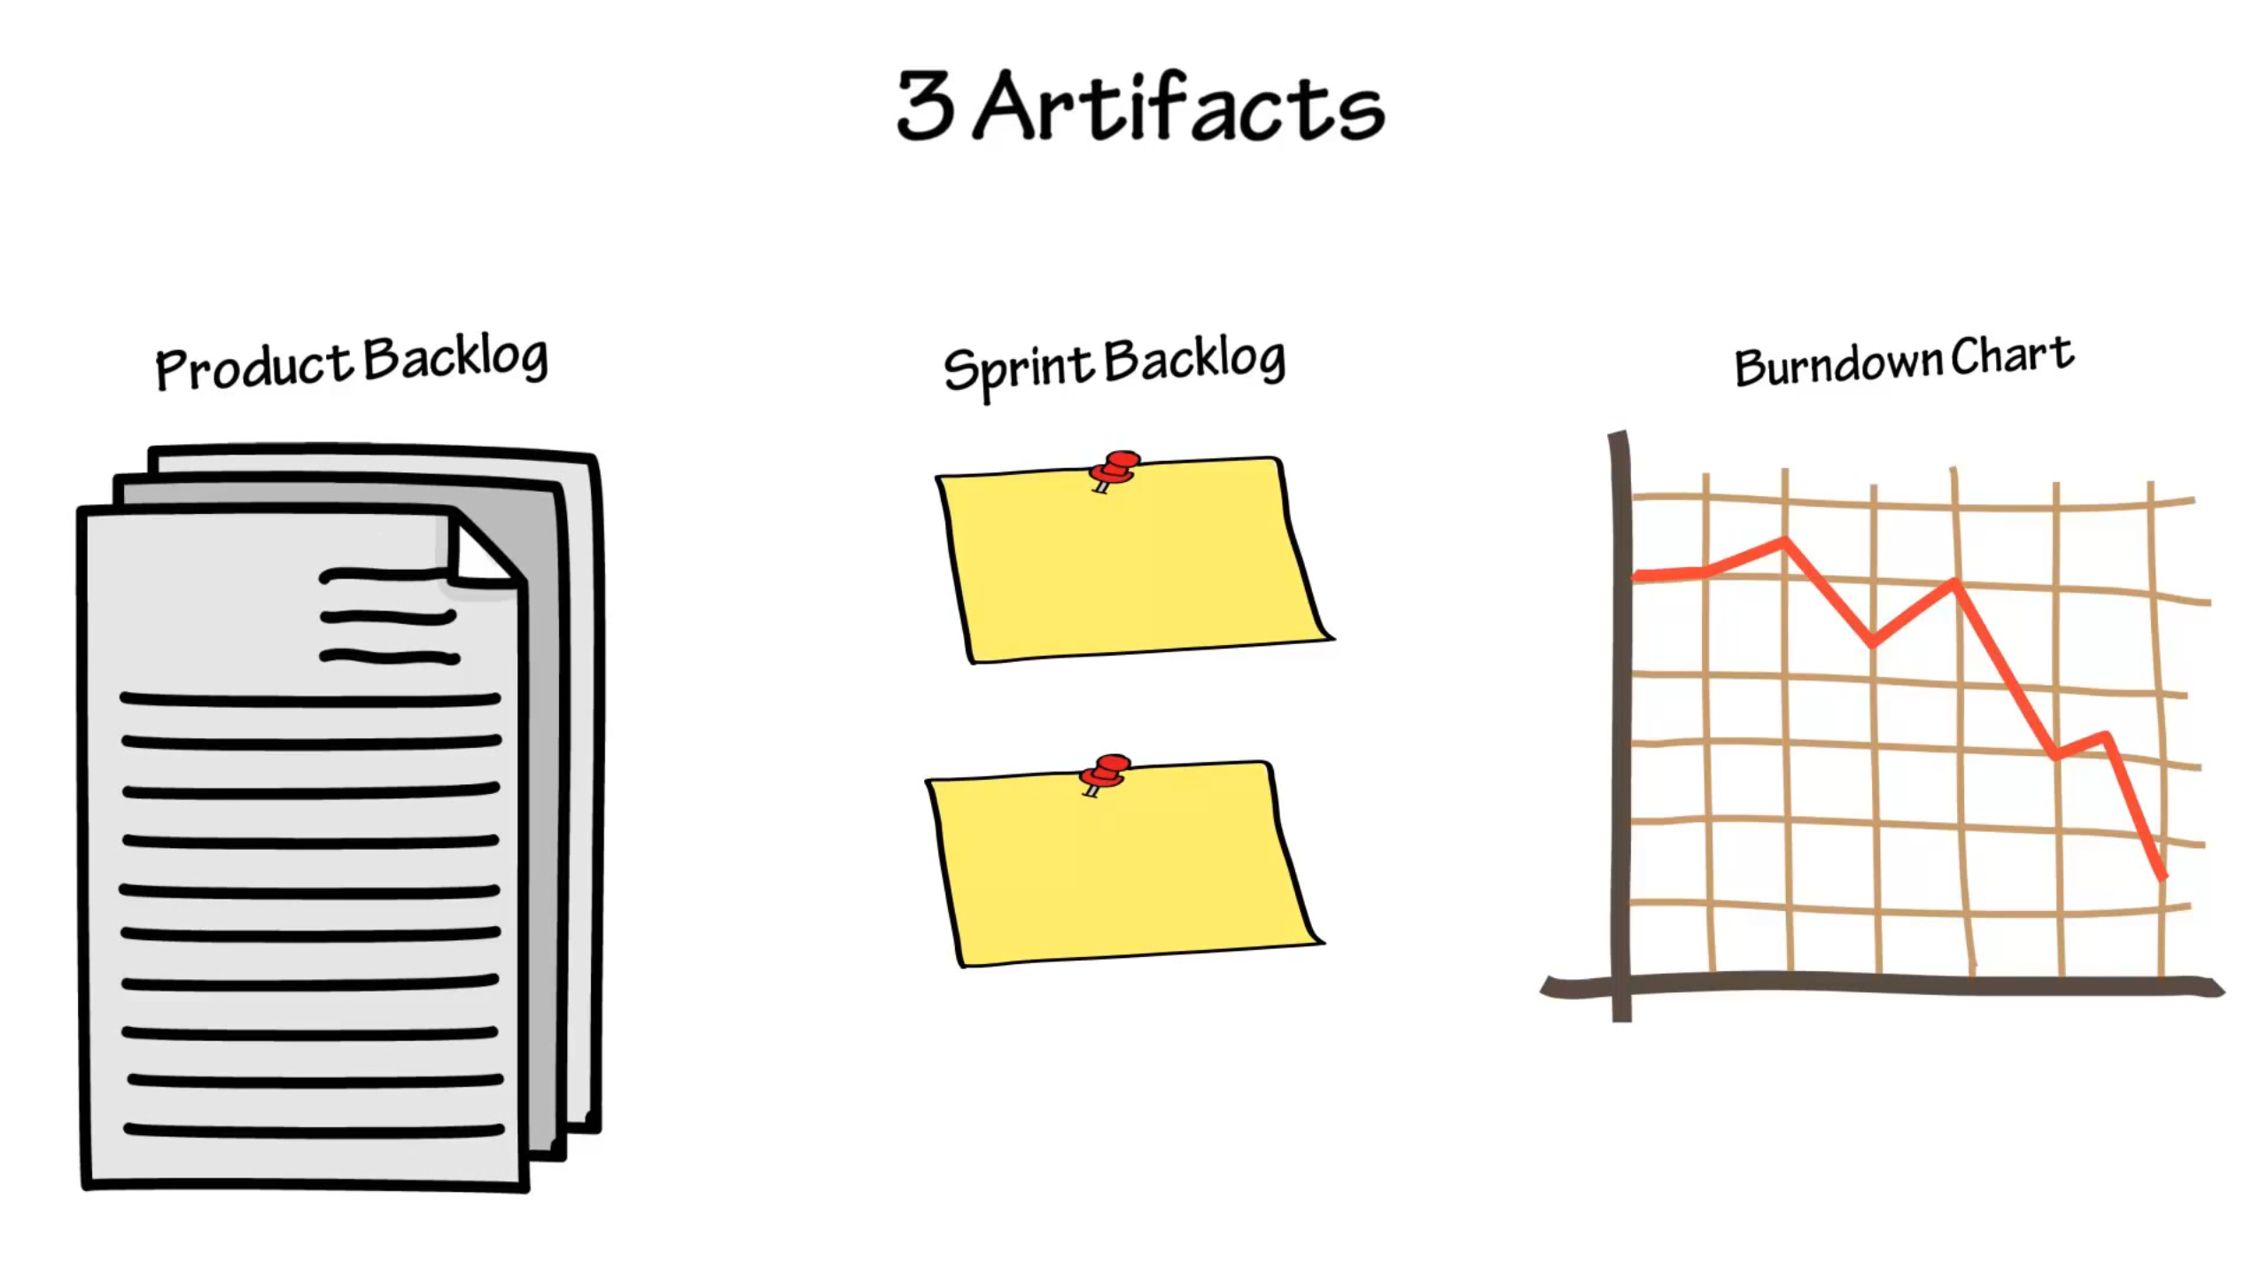
Notes:
Product backlog: product owners create a prioritized backlog of user stories that could go into the product
Sprint backlog: Highest priority user stories go in here
Burndown chart: to measure the product completion

Slide 16
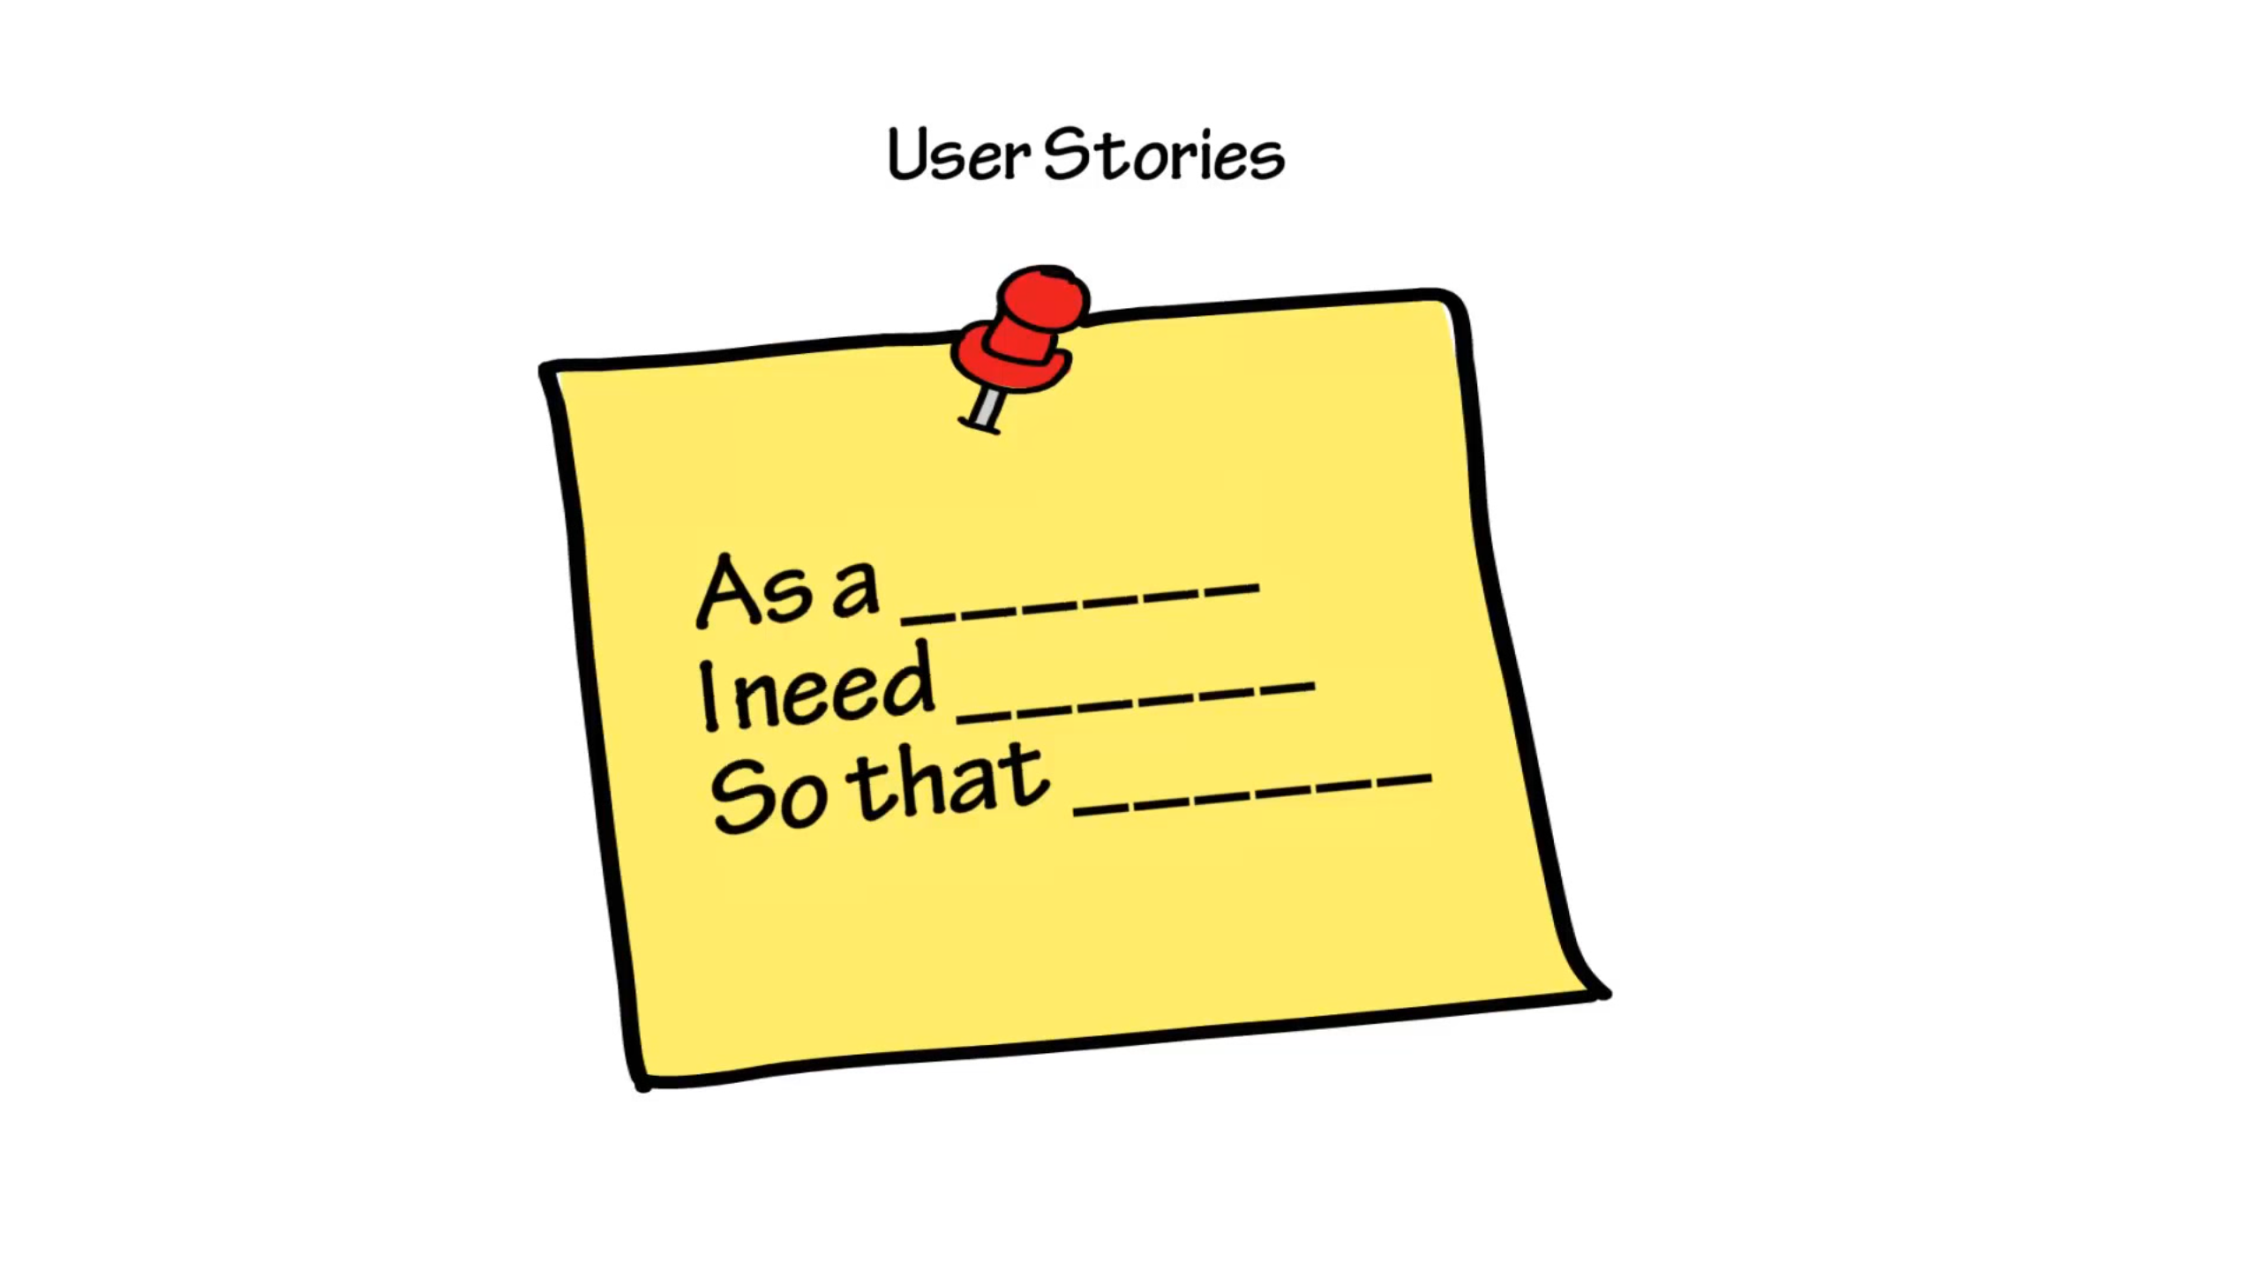
Notes:
A way of describing a feature set in this format, this gives developers the right amount of detail to understand a task and estimate its size
As a user, I am able to able to provide best support service to my customer.
Evaluating a User story
User story should be small enough to have a clear acceptance criteria that the team understands and can create in a "short period“
User story should be big enough to represent stand-alone business value
User story should also be big enough to be a deliverable on its own.

Slide 17
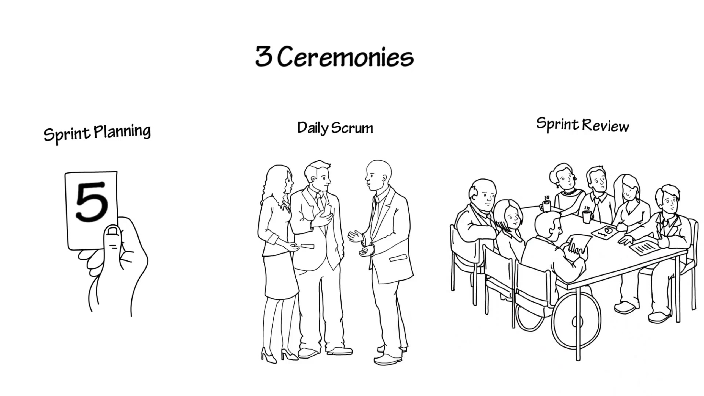
Notes:
Sprint planning: done at the start of the sprint, product owner, scrum master and team meet to discuss user story and estimate their sizes
Daily scrum: standup 15 minute meeting to see
What has been completed?
What are you working on?
Where are you stuck?
Sprint Review: At the end of each sprint, demonstrate the completed work. Discuss what worked and what can be improved in the sprint

Slide 18
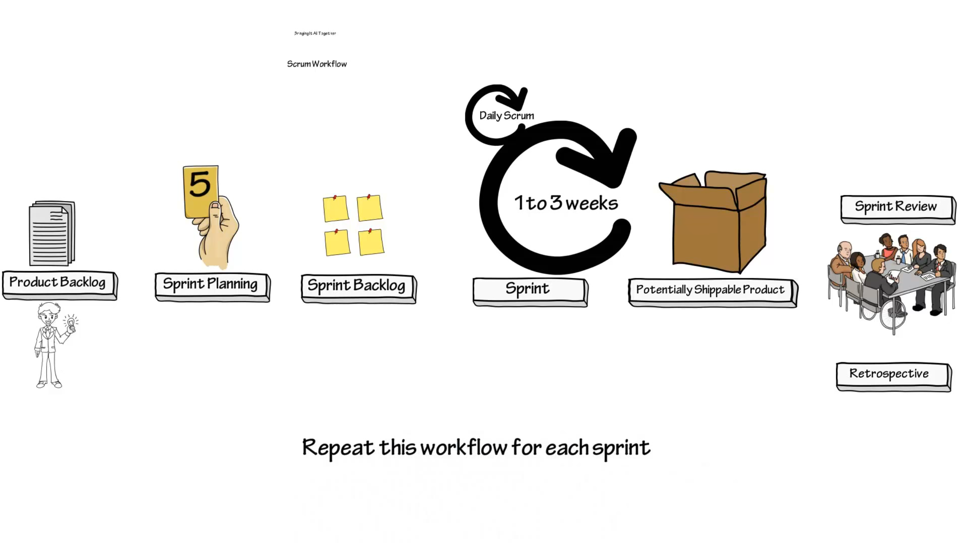
Notes:
Product backlog: product owners create a prioritized backlog of user stories that could go into the product
Sprint planning: Everyone meets to decide which stories will go into the next sprint
Sprint backlog: User stories for the sprint and everyone is suppose to fully understand these user stories
Sprint: Work is done here 1-3 weeks time with daily scrum
Potential Shippable Product: Product owner can decide if it is ready to ship, or if it needs more features
Sprint Review: Team showcases their work to product owner
Retrospective: Team works on what they can do to improve their process

Slide 19
References
What is Agile Development (Part 1): What is Agile Development?
Introduction to Scrum - 7 Minutes
Notes:
Work for a while, review and make all the necessary changes
The development is iterative in small sprints a week or two week time spans

